Slide 1


Web Technology
Topic:
Internet Protocol & HTTP
By
Prof. Jordan S. Choudhari ( Assistant Professor, SIT , Lonavala)

Slide 2

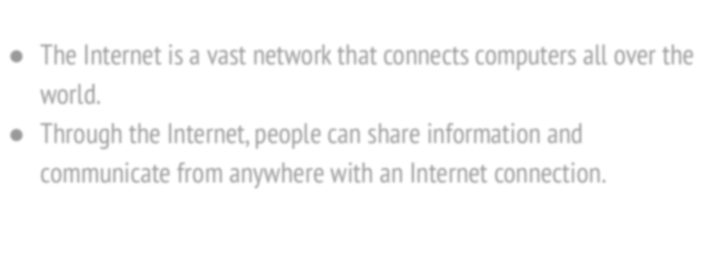
Internet
The Internet is a vast network that connects computers all over the world.
Through the Internet, people can share information and communicate from anywhere with an Internet connection.

Slide 3

Protocol
❏ Protocol set of standard rules that allows different types of computers to communicate with each other.
❏ The IP protocol ensures that each computer that is connected to the Internet is having a speciﬁc serial number called the IP address

Slide 4


Internet Protocols
SMTP(Simple Mail Transfer Protocol)
PPP(Point to Point Protocol)
FTP (File Transfer Protocol)
SFTP(Secure File Transfer Protocol)
HTTP(Hypertext Transfer Protocol)
HTTPS(Hypertext Transfer Protocol Secure
TELNET(Terminal Network)
POP3(Post Office Protocol

Slide 5

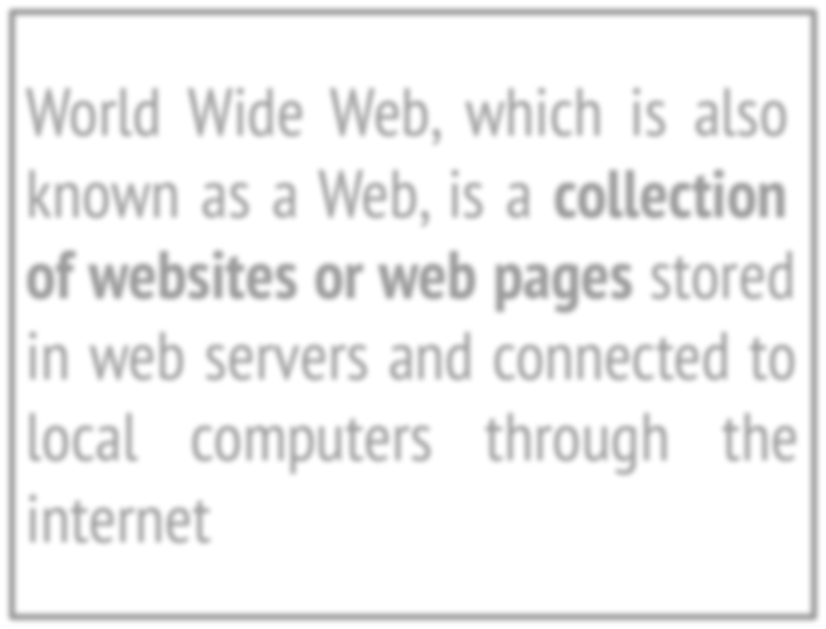

WWW- World Wide Web
World Wide Web, which is also known as a Web, is a collection of websites or web pages stored in web servers and connected to local computers through the internet

Slide 6





HTTP
HTTP
Hyper
Text
Transfer
Protocol

Slide 7

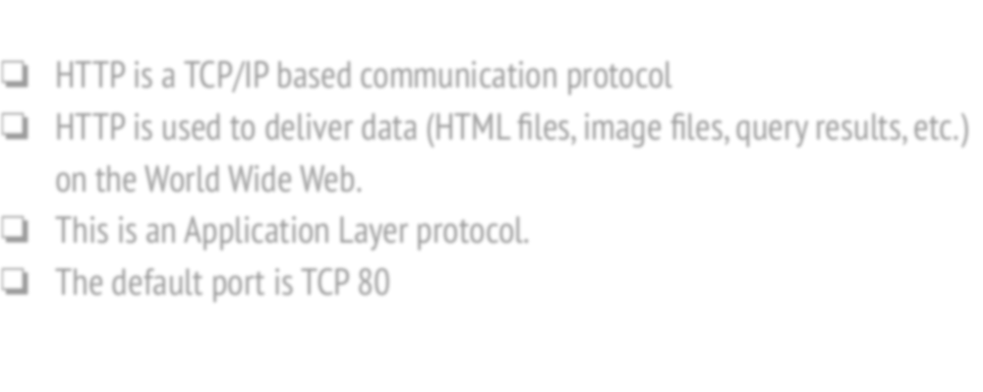
HTTP Protocol
❏ HTTP is a TCP/IP based communication protocol
❏ HTTP is used to deliver data (HTML ﬁles, image ﬁles, query results, etc.) on the World Wide Web.
❏ This is an Application Layer protocol.
❏ The default port is TCP 80

Slide 8
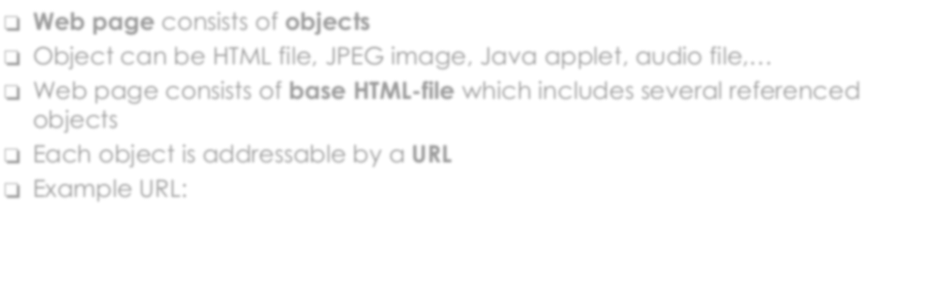
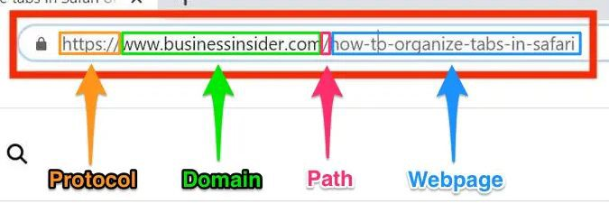
Web and HTTP
❏ Web page consists of objects
❏ Object can be HTML file, JPEG image, Java applet, audio file,…
❏ Web page consists of base HTML-file which includes several referenced objects
❏ Each object is addressable by a URL
❏ Example URL:

Slide 9

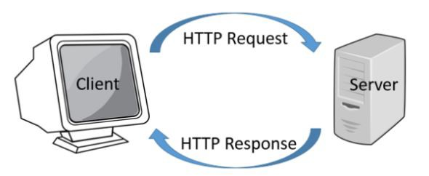
HTTP Protocol Model

Slide 10

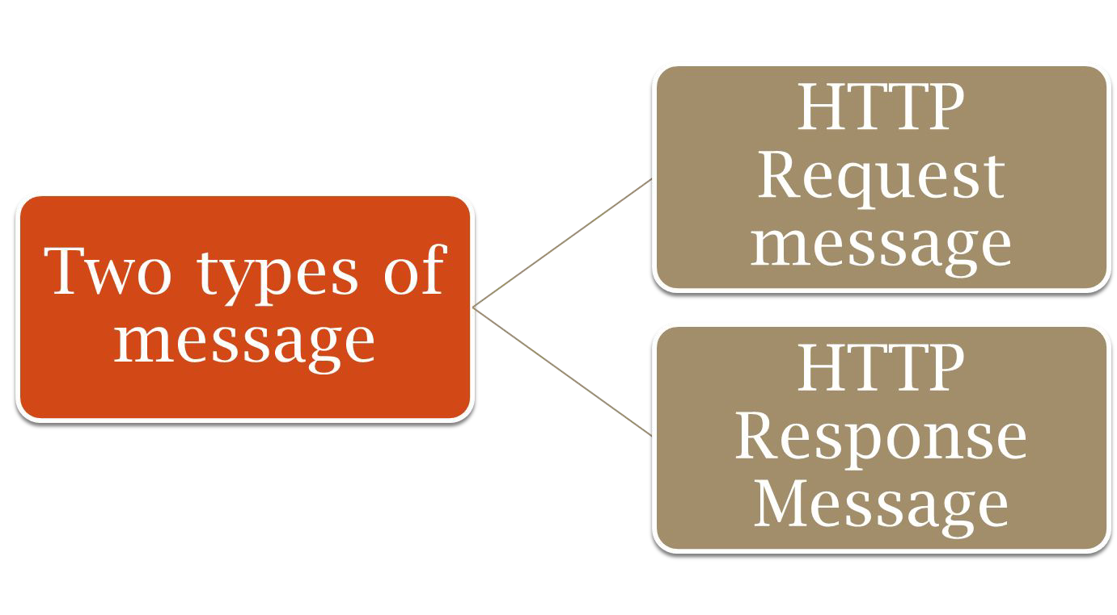
HTTP Request and Response Message

Slide 11

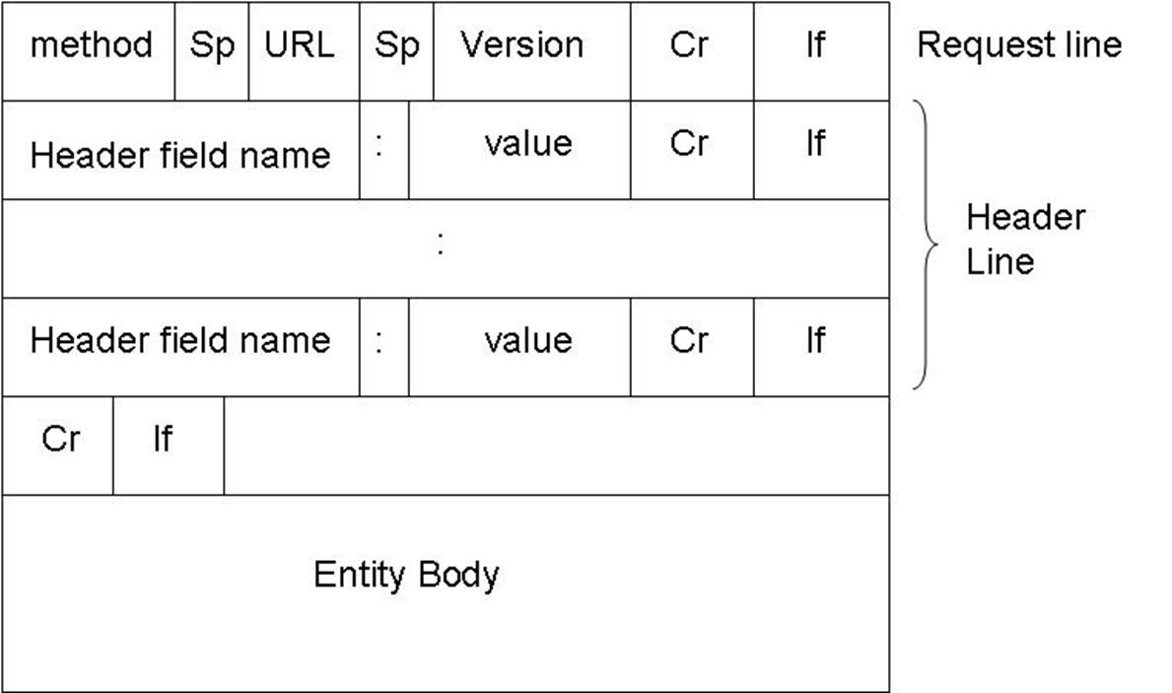
HTTP Request Messge

Slide 12
HTTP request message Example
request line (GET, POST,
HEAD commands)
GET /somedir/page.html HTTP/1.1 Host: www.someschool.edu
_{header} User-agent: Mozilla/4.0
_{lines} Connection: close Accept-language:fr
Carriage return, line feed indicates end of message
(extra carriage return, line feed)

Slide 13

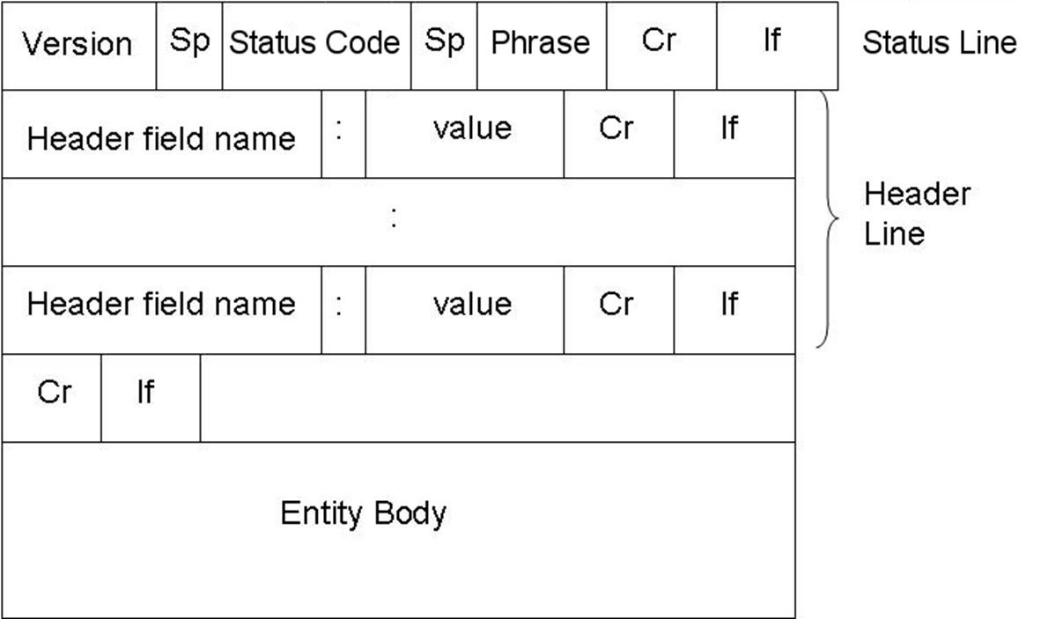
HTTP Response Message

Slide 14
HTTP response message example
status line (protocol status code status phrase)
HTTP/1.1 200 OK
Connection close
Date: Thu, 06 Aug 1998 12:00:15 GMT
Server: Apache/1.3.0 (Unix)
Last-Modified: Mon, 22 Jun 1998 …...
Content-Length: 6821 Content-Type: text/html
header lines
data, e.g., requested HTML file
data data data data data ...

Slide 15

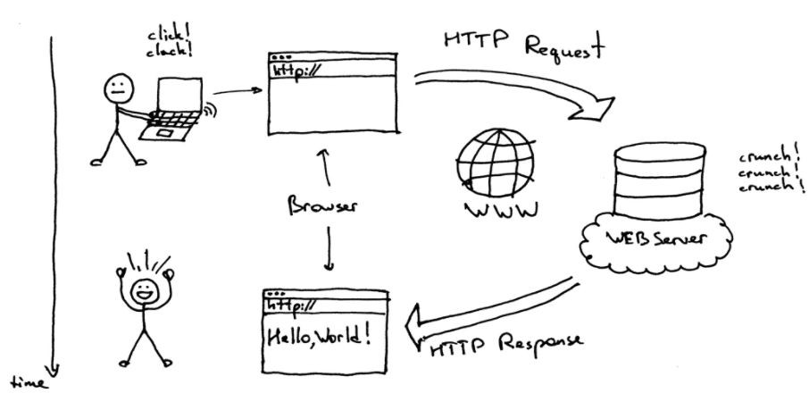
Web Client and Web Server

Slide 16

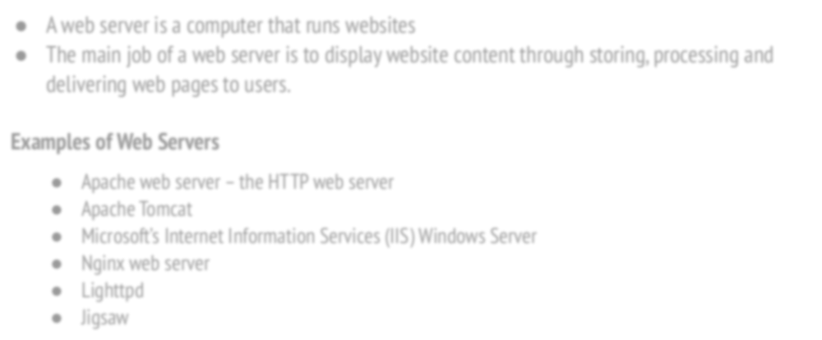
What is Web Server?
A web server is a computer that runs websites
The main job of a web server is to display website content through storing, processing and delivering web pages to users.
Examples of Web Servers
Apache web server – the HTTP web server
Apache Tomcat
Microsoft’s Internet Information Services (IIS) Windows Server
Nginx web server
Lighttpd
Jigsaw

Slide 17

What is Web Browser?
Web Browsers are software installed on your PC. To access the Web you need a web browsers.
Examples of Web Browsers
Netscape Navigator,
Google Chrome
Microsoft Internet Explorer
Mozilla Firefox.

Slide 18

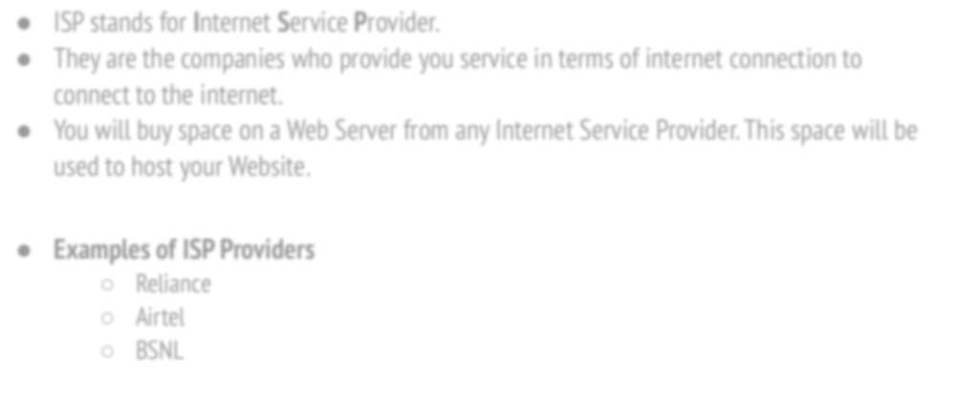
What is ISP?
ISP stands for Internet Service Provider.
They are the companies who provide you service in terms of internet connection to connect to the internet.
You will buy space on a Web Server from any Internet Service Provider. This space will be used to host your Website.
Examples of ISP Providers
Reliance
Airtel
BSNL

Slide 19

Web Technology
Topic: HTML

Slide 20

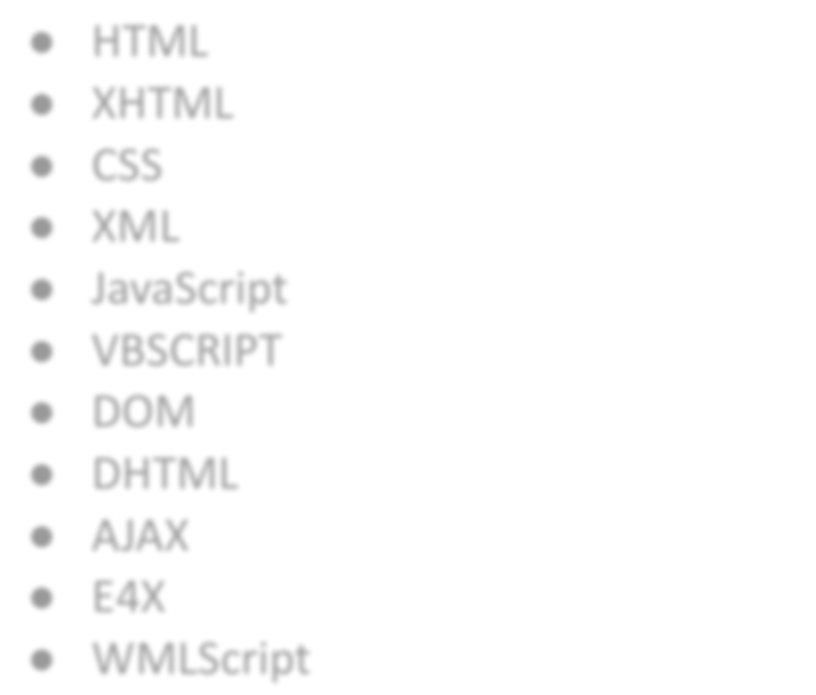
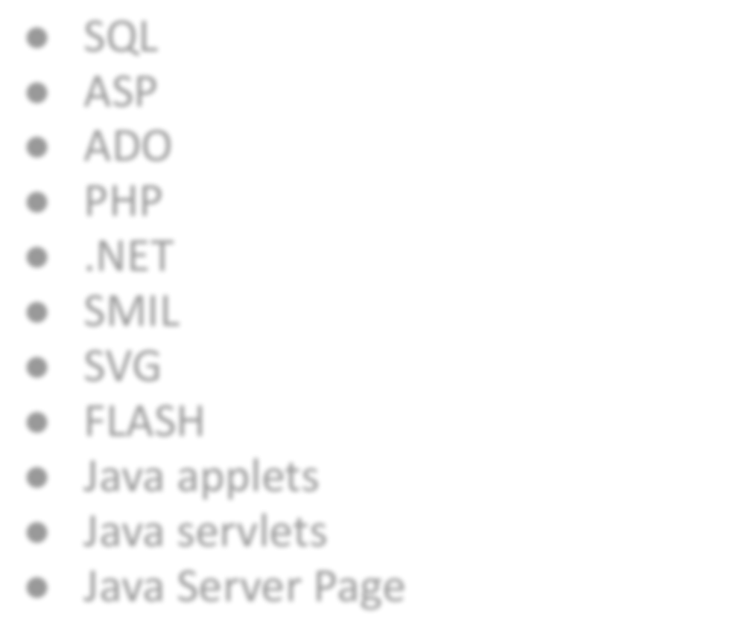
Different Web Technologies
HTML
XHTML
CSS
XML
JavaScript
VBSCRIPT
DOM
DHTML
AJAX
E4X
WMLScript
SQL
ASP
ADO
PHP
.NET
SMIL
SVG
FLASH
Java applets
Java servlets
Java Server Page

Slide 21

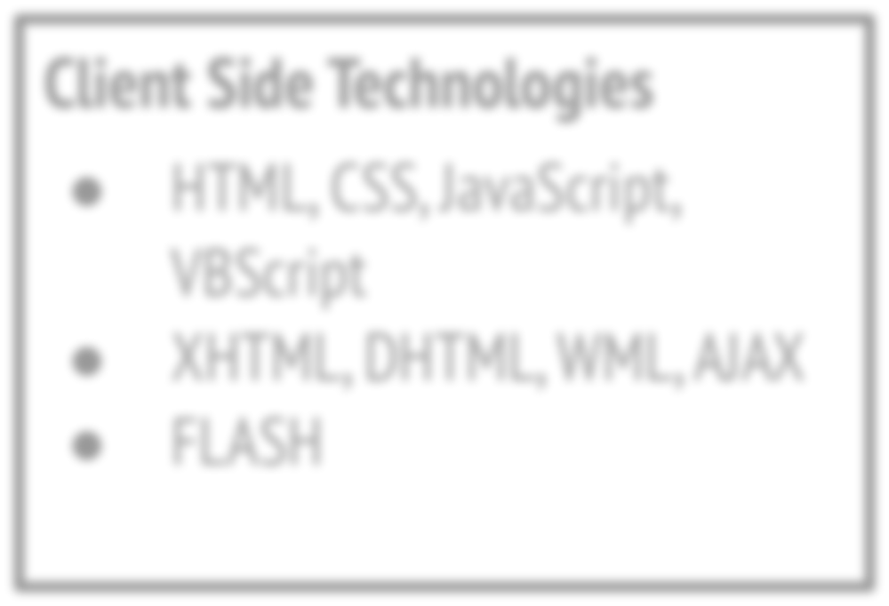
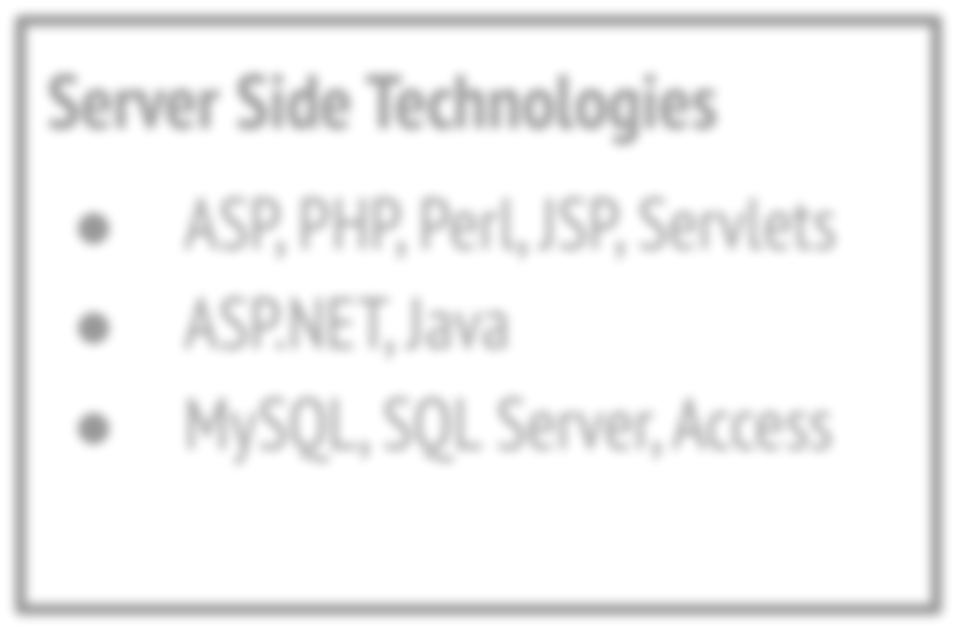
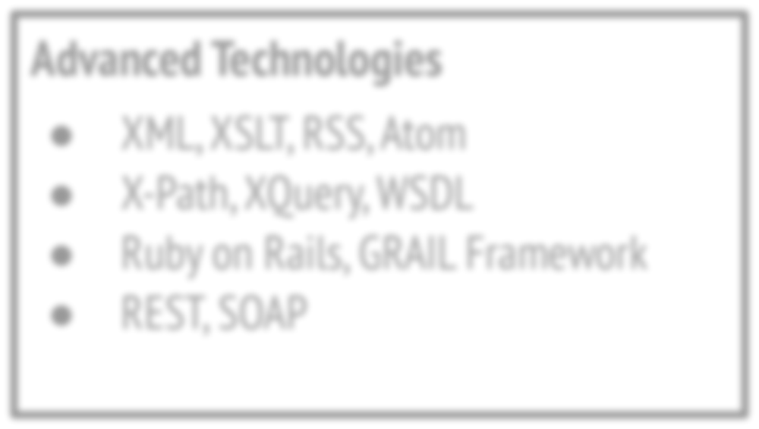
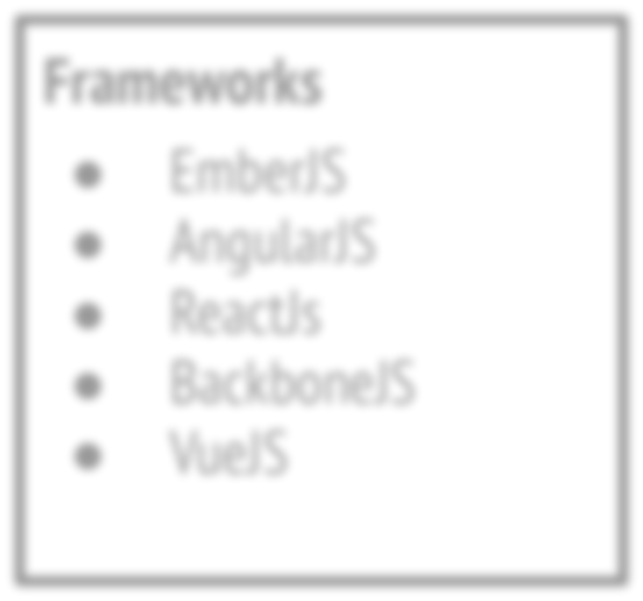
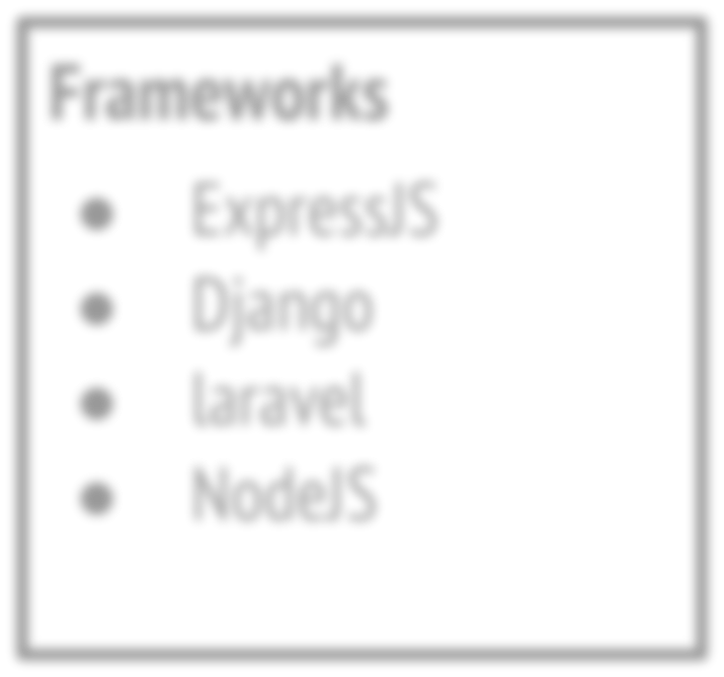
List of Technologies
Client Side Technologies
HTML, CSS, JavaScript, VBScript
XHTML, DHTML, WML, AJAX
FLASH
Server Side Technologies
ASP, PHP, Perl, JSP, Servlets
ASP.NET, Java
MySQL, SQL Server, Access
Advanced Technologies
XML, XSLT, RSS, Atom
X-Path, XQuery, WSDL
Ruby on Rails, GRAIL Framework
REST, SOAP
Frameworks
EmberJS
AngularJS
ReactJs
BackboneJS
VueJS
Frameworks
ExpressJS
Django
laravel
NodeJS

Slide 22

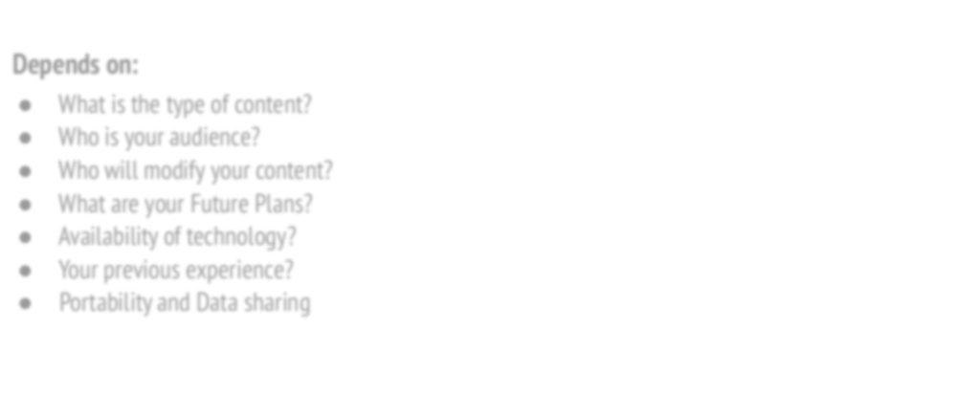
How to choose a technology?
Depends on:
What is the type of content?
Who is your audience?
Who will modify your content?
What are your Future Plans?
Availability of technology?
Your previous experience?
Portability and Data sharing

Slide 23

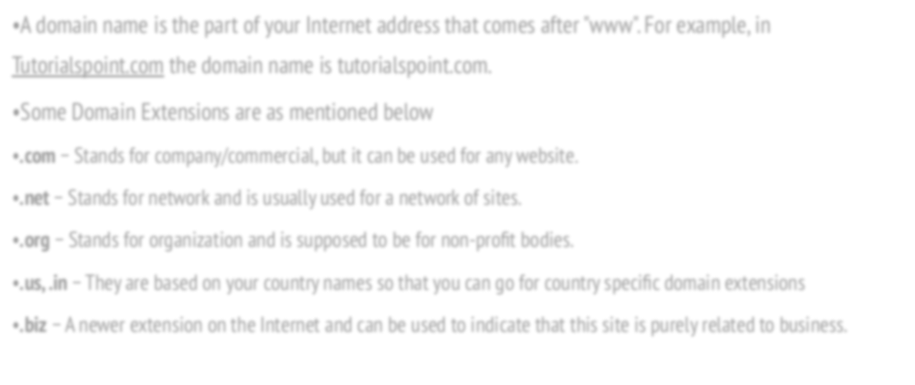
Web - Domain Names & Extension Types
•A domain name is the part of your Internet address that comes after "www". For example, in Tutorialspoint.com the domain name is tutorialspoint.com.
•Some Domain Extensions are as mentioned below
.com − Stands for company/commercial, but it can be used for any website.
.net − Stands for network and is usually used for a network of sites.
.org − Stands for organization and is supposed to be for non-proﬁt bodies.
.us, .in − They are based on your country names so that you can go for country speciﬁc domain extensions
.biz − A newer extension on the Internet and can be used to indicate that this site is purely related to business.

Slide 24

HTML
HTML
Hyper
Text
Markup
Language

Slide 25

HTML Intro
•HTML stands for Hyper Text Markup Language
•HTML is the standard markup language for creating Web pages
•HTML describes the structure of a Web page
•HTML consists of a series of elements
•HTML elements tell the browser how to display the content

Slide 26

HTML Versions
Version | Year
HTML | 1991
HTML 2.0 | 1995
HTML 3.2 | 1997
HTML 4.01 | 1999
XHTML | 2000
HTML5 | 2014

Slide 27

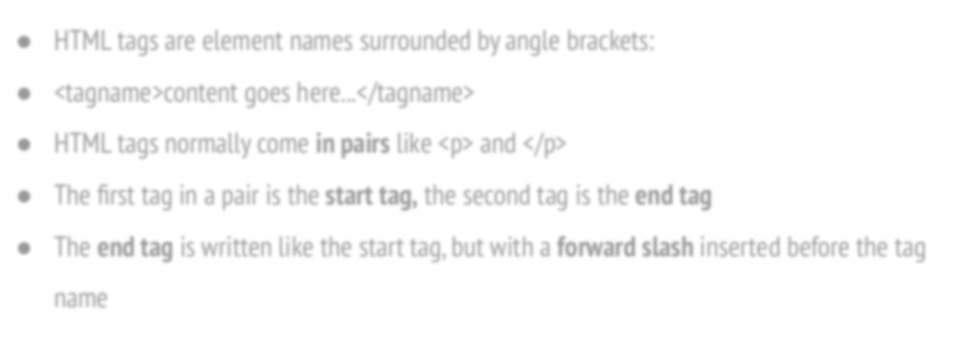
HTML Tags
HTML tags are element names surrounded by angle brackets:
<tagname>content goes here...</tagname>
HTML tags normally come in pairs like <p> and </p>
The ﬁrst tag in a pair is the start tag, the second tag is the end tag
The end tag is written like the start tag, but with a forward slash inserted before the tag name

Slide 28

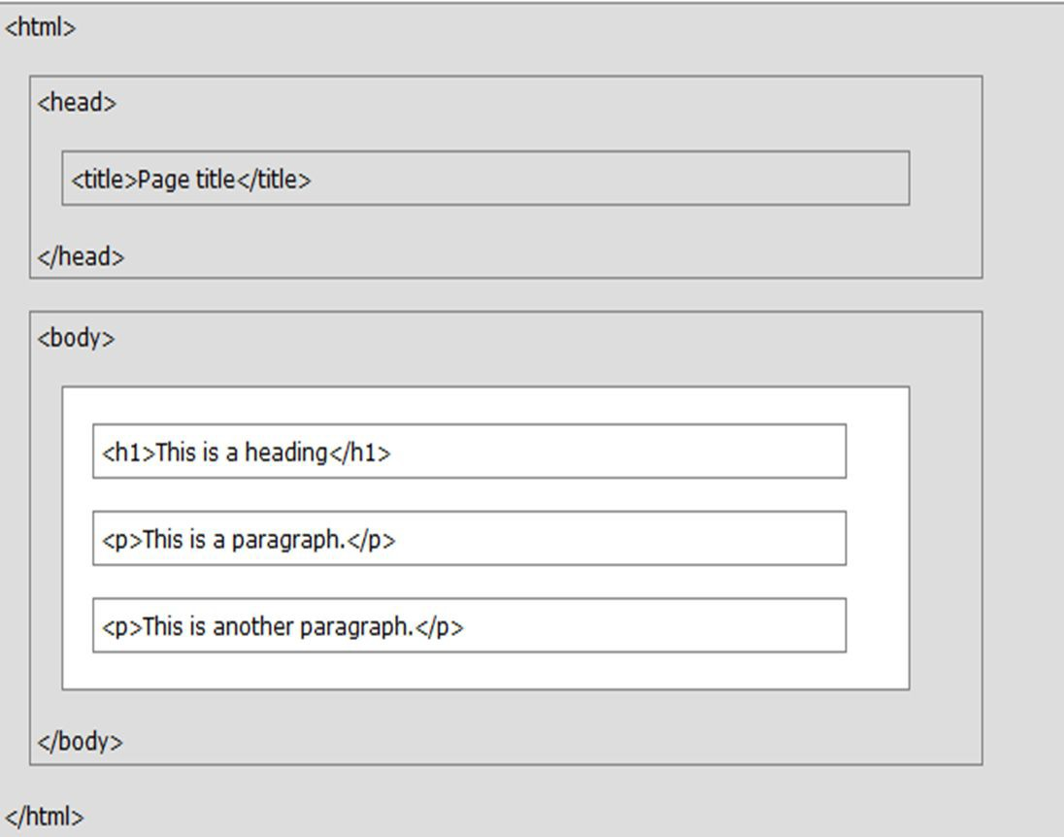
HTML Page Structure

Slide 29

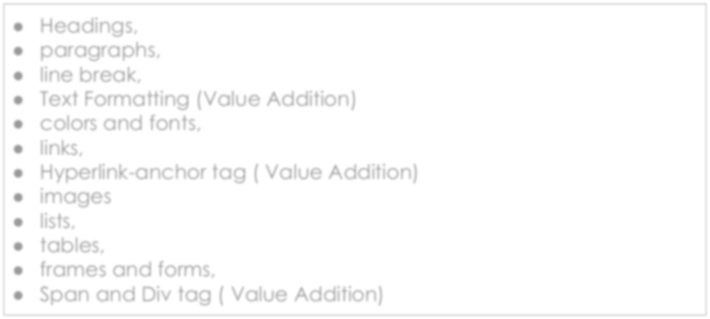
HTML Elements
Headings,
paragraphs,
line break,
Text Formatting (Value Addition)
colors and fonts,
links,
Hyperlink-anchor tag ( Value Addition)
images
lists,
tables,
frames and forms,
Span and Div tag ( Value Addition)

Slide 30

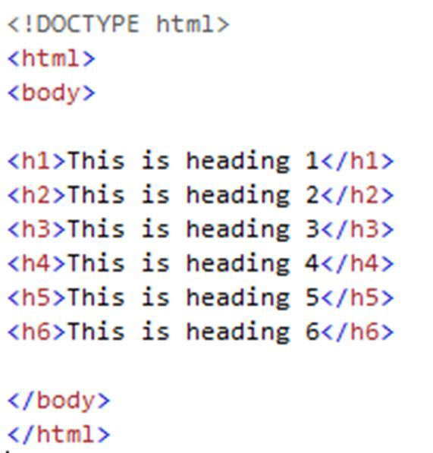
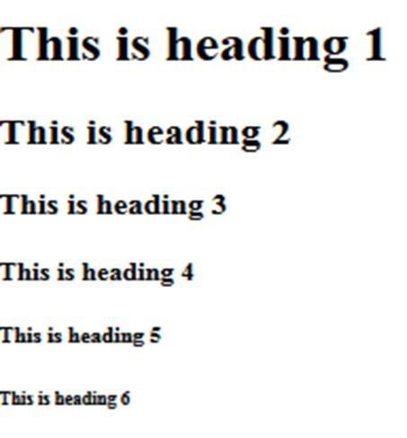
HTML- Heading Tags
HTML headings are deﬁned with the <h1> to <h6> tags. <h1> deﬁnes the most important heading. <h6> deﬁnes the least important heading:
Output

Slide 31

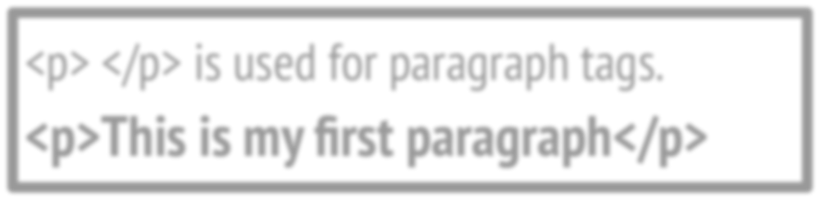
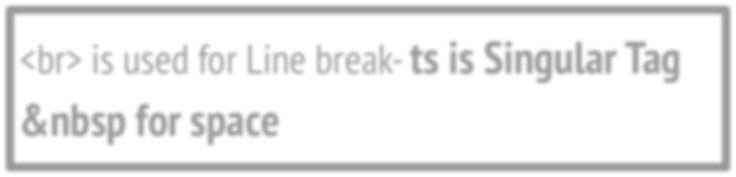
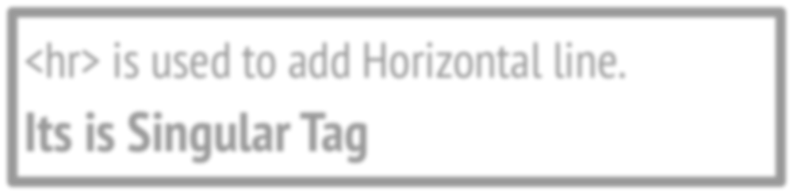
HTML- Paragraph Tag, Line Break and Horizontal Line
<p> </p> is used for paragraph tags.
<p>This is my ﬁrst paragraph</p>
<br> is used for Line break- it is Singular Tag &nbsp for space (non- breaking space)
<hr> is used to add Horizontal line.
Its is Singular Tag

Slide 32

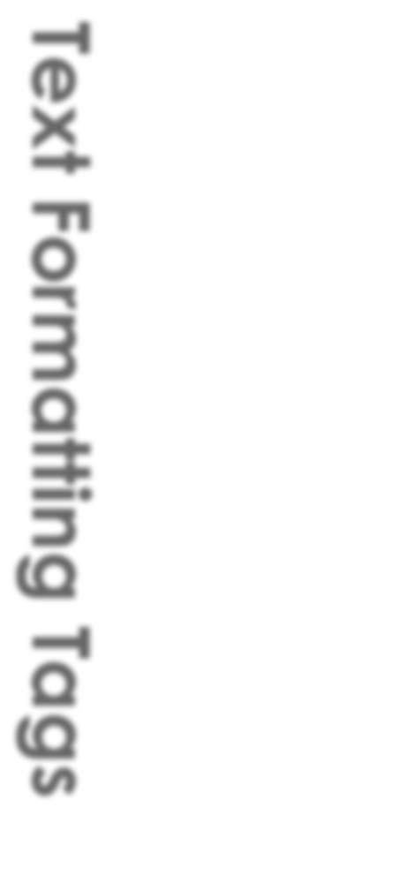
<b></b> | bold
<i></i> | italicized
<u></u> | underlined
<sup></sup> | _{Sample}superscript
<sub></sub> | ^{Sample}subscript
<strong></strong> | strong
<em></em> | emphasized
<pre></pre> | Preformatted text
<blockquote></blockquote> | Quoted text block
<del></del> | Deleted text – strike through
Text Formatting Tags

Slide 33


Fonts & Colors
<Font>
Text Comes Here
</Font>
What attributes can use with Font tag:
face
size
color

Slide 34

Fonts & Colors
You can set font face using face attribute
Example:- <font face = "Times New Roman" > Hello </font>
face
size
color

Slide 35

Fonts & Colors
You can set content font size using size attribute.
The range of accepted values is from 1(smallest) to 7(largest).
The default size of a font is 3
Example:- <font size = "5"> Hello </font>
face
size
color

Slide 36

Fonts & Colors
You can set font color using color attribute.
You can specify the color either by color name or hexadecimal code for that color.
<font color = "#FF00FF"> Hello </font>
<font color = "red"> Hello </font>
face
size
color

Slide 37


Fonts & Colors
You can set font face using face attribute
Example:- <font face = "Times New Roman" > Hello </font>
You can set content font size using size attribute.
The range of accepted values is from 1(smallest) to 7(largest).
The default size of a font is 3
Example:- <font size = "5"> Hello </font>
face
size
color
You can set font color using color attribute.
You can specify the color either by color name or hexadecimal code for that color.
<font color = "#FF00FF"> Hello </font>
<font color = "red"> Hello </font>

Slide 38

HyperLinks- Value Addition
The <a> tag deﬁnes a hyperlink, which is used to link from one page to another
The href attribute of <a> element indicates the link's destination The target attribute speciﬁes where to open the linked document.
Example- target = _blank - Opens the linked document in a new window or tab

Slide 39

HyperLinks
Link to a document called a1.html in the same directory
<a href="a1.html"> Click </a>
Link to a document called parent.html in the parent directory
<a href="../parent.html"> Click </a>
Link to a document called a1.html in the subdirectory WTL
<a href="WTL/a1.html"> Click </a>
Link to an external Web site sit.edu
<a href="http://www.sit.edu"> ClickHere</a>

Slide 40
HyperLinks
Link to the same Document
Example:-
<a href="#section1">Introduction</a><br>
<a href="#section2">background</a><br>
<h2 id="section1">Introduction</h2>
... Section 1 follows here …
<h2 id="section2">background</h2>
... Section 2 follows here ...

Slide 41

Link tag
<head>
<link rel="stylesheet" href="styles.css">
</head>
Link tag is used to Link to an external style sheet
The <link> tag deﬁnes the relationship between the current document and an external resource.
rel- Required attribute. It speciﬁes the relationship between the current document and the linked document

Slide 42

Images- img tag
<img src= “index.jpeg” >
src | Location of image file (relative or absolute)
alt | Substitute text for display (e.g. in text mode)
height | Number of pixels of the height
width | Number of pixels of the width
border | Size of border, 0 for no border
img tag attributes
<img src= “index.jpeg” alt= “Home page” height= "500" width="600" border= “2” >

Slide 43




List Types
List tag
Ordered
Unordered
Definition
<ol>
<ul>
<dl>

Slide 44

List tag- Ordered List
<ol>
<li>Apple</li>
<li>Orange</li>
<li>Grapefruit</li>
</ol>
<ol type="A" >
<li>Apple</li>
<li>Orange</li>
<li>Grapefruit</li>
</ol>
<ol type="a" >
<li>Apple</li>
<li>Orange</li>
<li>Grapefruit</li>
</ol>
Apple
Orange 3.Grapefruit
Apple
Orang
Grapefruit
<ol type="1" >
<li>Apple</li>
<li>Orange</li>
<li>Grapefruit</li>
</ol>
<ol type="I" >
<li>Apple</li>
<li>Orange</li>
<li>Grapefruit</li>
</ol>
<ol type="i" >
<li>Apple</li>
<li>Orange</li>
<li>Grapefruit</li>
</ol>
Apple
Orange 3.Grapefruit
Apple
Orang
Grapefruit

Slide 45

List tag- Unordered List
<ul >
<li>Apple</li>
<li>Orange</li>
<li>Grapefruit</li>
</ul>
<ul type="disk" >
<li>Apple</li>
<li>Orange</li>
<li>Grapefruit</li>
</ul>
Apple
Orange
Grapefruit
Apple
Orange
Grapefruit
<ul type="Square" >
<li>Apple</li>
<li>Orange</li>
<li>Grapefruit</li>
</ul>
<ul type="Circle" >
<li>Apple</li>
<li>Orange</li>
<li>Grapefruit</li>
</ul>
❏ Apple
❏ Orange
❏ Grapefruit
Apple
Orang
Grapefruit

Slide 46

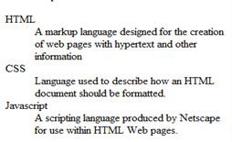
List tag- Definition List
Create deﬁnition lists using <dl>
deﬁnition in <dd> tag
text is in <dt> tag,
<dl>
<dt>HTML</dt>
<dd>A markup language …</dd>
<dt>CSS</dt>
<dd>Language used to …</dd>
</dl>

Slide 47


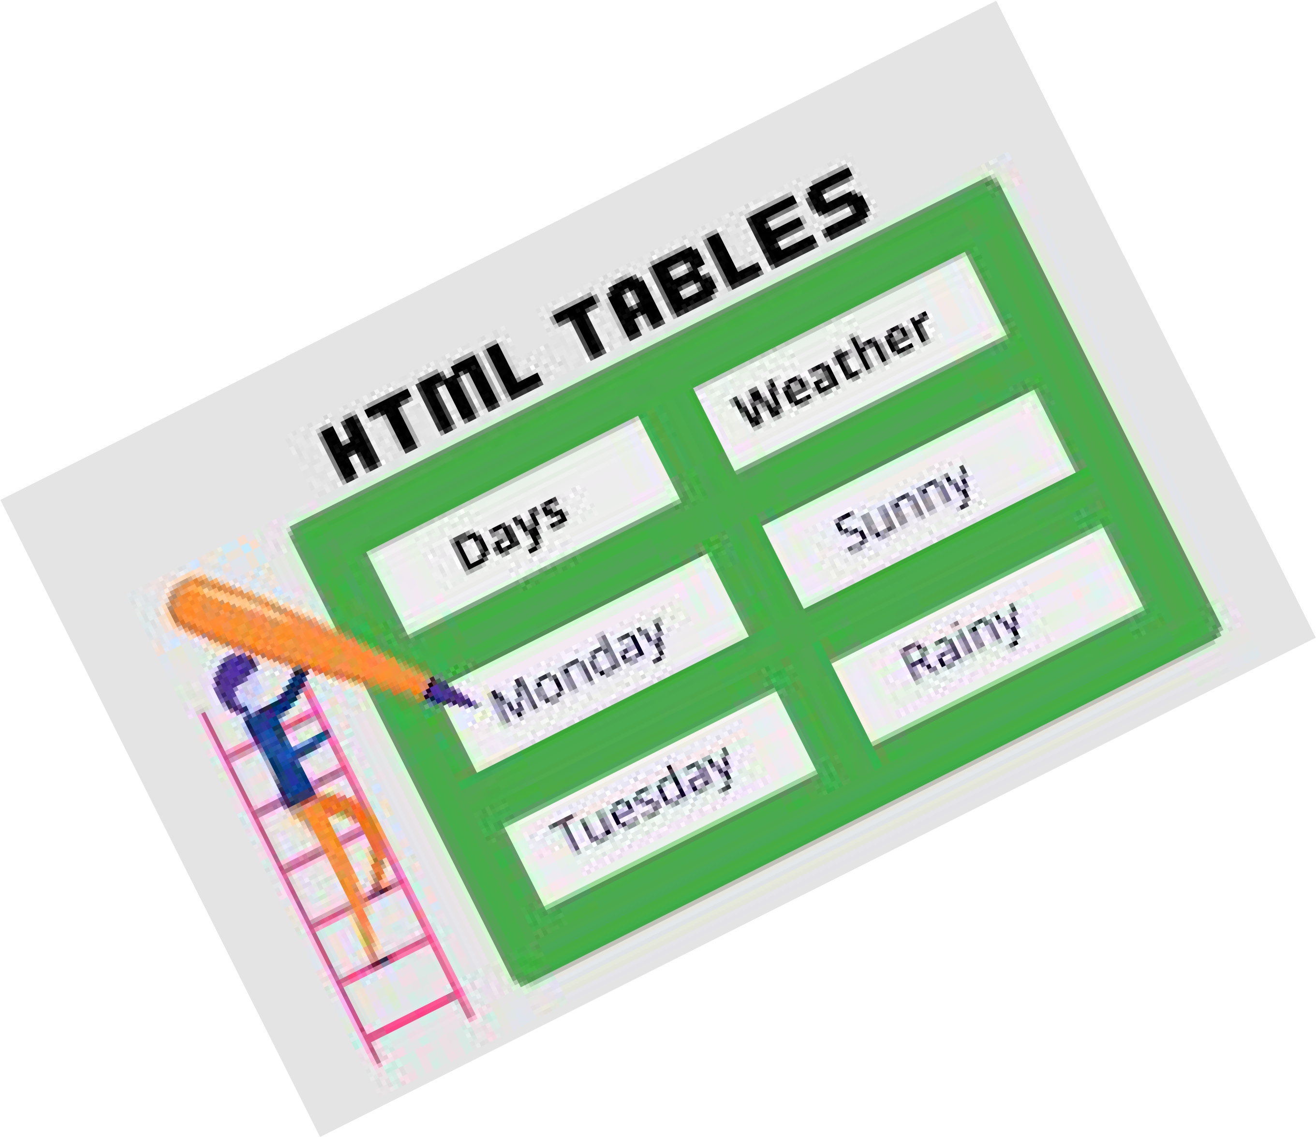
HTML Table

Slide 48
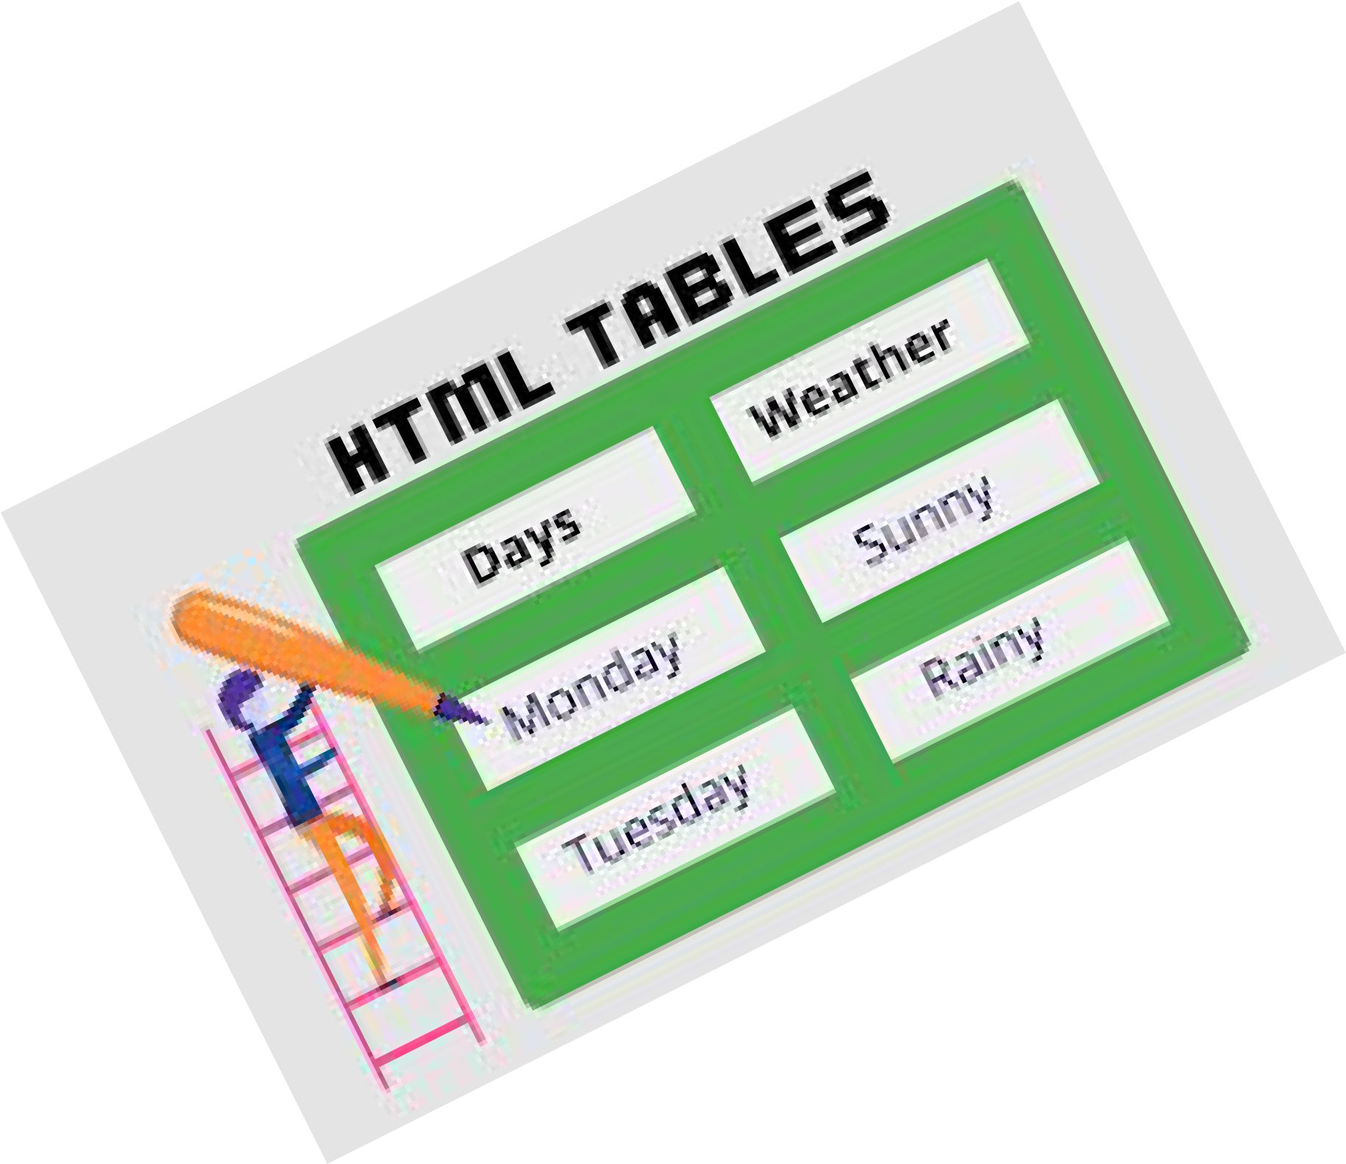
HTML Table
Tag | Description
<table> | Deﬁnes a table
<th> | Deﬁnes a header cell in a table
<tr> | Deﬁnes a row in a table
<td> | Deﬁnes a cell in a table
<caption> | Deﬁnes a table caption
<colgroup> | Speciﬁes a group of one or more columns in a table for formatting
<col> | Speciﬁes column properties for each column within a <colgroup> element
<thead> | Groups the header content in a table
<tbody> | Groups the body content in a table
<tfoot> | Groups the footer content in a table

Slide 49




HTML Table
<tr>
<th>
<th>
<th>
<tr>
<tr>
<tr>
<td>
<td>
<td>

Slide 50
HTML Table Example-1
Student Database Table
Roll-No | Name | Address
1 | Bhavana | Nashik
2 | Amit | Pune
3 | Neha | Mumbai

Slide 51


HTML Table Example-1
<html>
<body>
<table border=1 width=50% cellspacing=0>
<tr>
<td>2</td>
<td>Amit</td>
<td>Pune</td>
</tr>
<tr>
<td>3</td>
<td>Neha</td>
<td>Mumbai</td>
</tr>
</table>
</body>
</html>
<tr>
<th>RollNo</th>
<th>Name</th>
<th>Address</th>
</tr>
<tr>
<td>1</td>
<td>Bhavana</td>
<td>Nashik</td>
</tr>

Slide 52
HTML Table Example-2
Roll-No | Name | Address
1 | Bhavana | Nashik
2 | Amit | Pune
3 | Neha | Mumbai

Slide 53

HTML Table Example-2
<html>
<body>
<table border=1 width=50% cellspacing=0>
<tr bgcolor=red>
<th>RollNo</th>
<th>Name</th>
<th>Address</th>
</tr>

Slide 54
HTML Table Example-3
Roll-No | Name | Address
1 | Bhavana | Nashik
2 | Amit | Pune
3 | Neha | Mumbai
4 | Sameer | Chandwad
5 | Varun | Bhopal

Slide 55
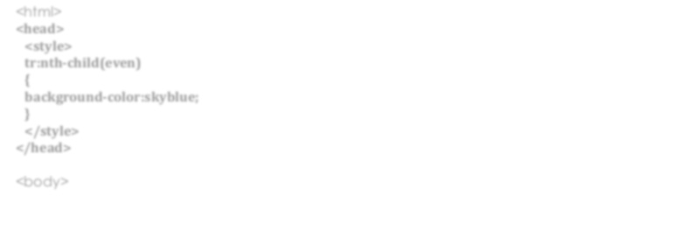
HTML Table Example-3
<html>
<head>
<style>
tr:nth-child(even)
{
background-color:skyblue;
}
</style>
</head>
<body>

Slide 56
HTML Table Example-4
Roll-No | Name | Address
1 | Bhavana | Nashik
2 | Amit | Pune
3 | Neha | Mumbai
4 | Sameer | Chandwad
5 | Varun | Bhopal

Slide 57

HTML Table Example-4
<html>
<body>
<table border=1 width=50% cellspacing=0>
<colgroup>
<col style="background-color:skyblue">
</colgroup>
<tr>
<th>RollNo</th>
<th>Name</th>
<th>Address</th>
</tr>
<tr>

Slide 58

HTML Table Example- 5
Month | Savings
January | $100
February | $80
Sum | $180
<thead>
<tbody>
<tfoot>

Slide 59
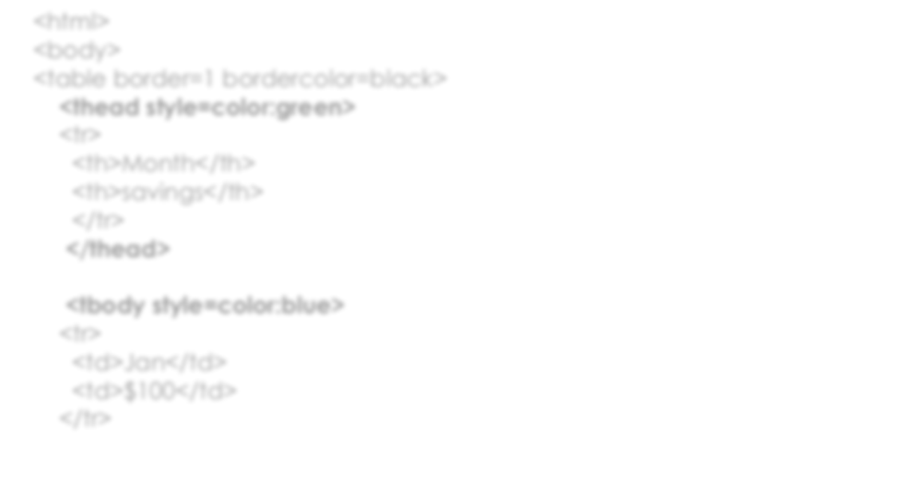
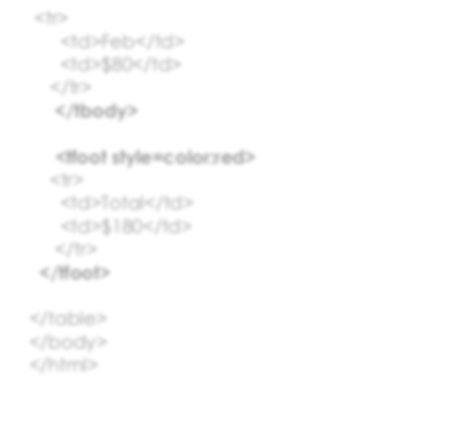
HTML Table Example- 5
<html>
<body>
<table border=1 bordercolor=black>
<thead style=color:green>
<tr>
<th>Month</th>
<th>savings</th>
</tr>
</thead>
<tbody style=color:blue>
<tr>
<td>Jan</td>
<td>$100</td>
</tr>
<tr>
<td>Feb</td>
<td>$80</td>
</tr>
</tbody>
<tfoot style=color:red>
<tr>
<td>Total</td>
<td>$180</td>
</tr>
</tfoot>
</table>
</body>
</html>

Slide 60
HTML Table Example-6
Time/Day | Monday | Tuesday | Wednesday | Thursday
10:00-11:00 | DBMS | Maths | DBMS | DBMS
11:00-12:00 | WT | DBMS | WT | Maths
12:00-12:30 | Lunch Break
12:30-1:30 | Maths | DBMSL(PR) T1 Batch | Maths | DBMSL(PR) T2 Batch
1:30-2:30 | ADS |  | ADS

Slide 61

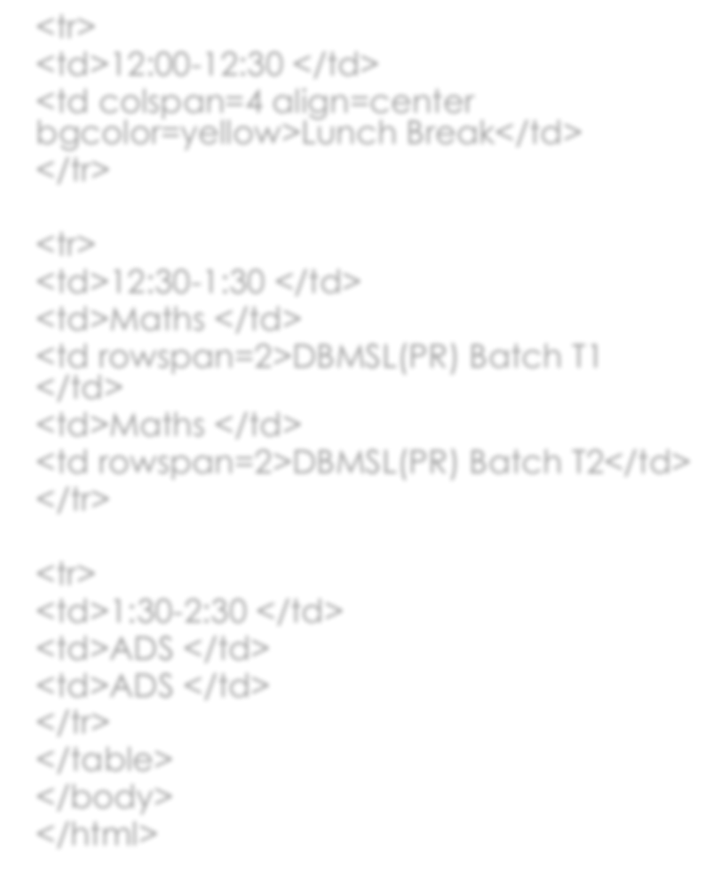
<html>
<body>
<table border=1 width=50% align=center>
<tr>
<th>Time/Day </th>
<th> Mon </th>
<th> Tue </th>
<th> Wed </th>
<th> Thus </th>
</tr>
<tr>
<td>10:00-11:00 </td>
<td>DBMS </td>
<td>Maths </td>
<td>DBMS </td>
<td>DBMS</td>
</tr>
<tr>
<td>11:00-12:00 </td>
<td>WT </td>
<td>DBMS </td>
<td>WT </td>
<td>Maths</td>
</tr>
<tr>
<td>12:00-12:30 </td>
<td colspan=4 align=center
bgcolor=yellow>Lunch Break</td>
</tr>
<tr>
<td>12:30-1:30 </td>
<td>Maths </td>
<td rowspan=2>DBMSL(PR) Batch T1
</td>
<td>Maths </td>
<td rowspan=2>DBMSL(PR) Batch T2</td>
</tr>
<tr>
<td>1:30-2:30 </td>
<td>ADS </td>
<td>ADS </td>
</tr>
</table>
</body>
</html>

Slide 62

Web Technology
Topic:
Div and Span tag

Slide 63

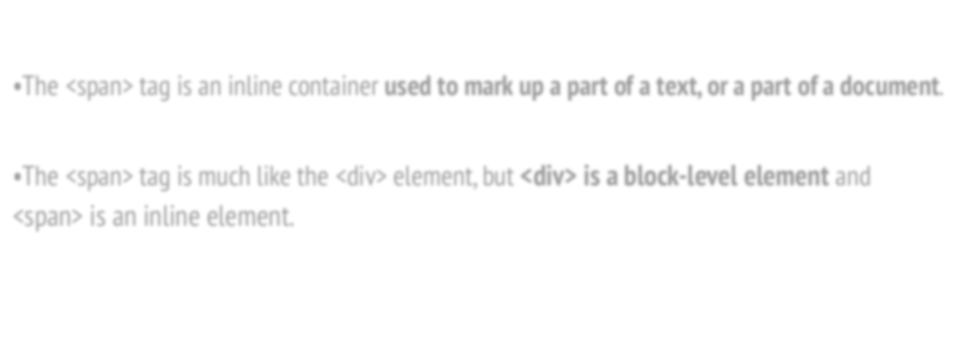
Span and Div tag- Value Addition
•The <span> tag is an inline container used to mark up a part of a text, or a part of a document.
•The <span> tag is much like the <div> element, but <div> is a block-level element and
<span> is an inline element.

Slide 64
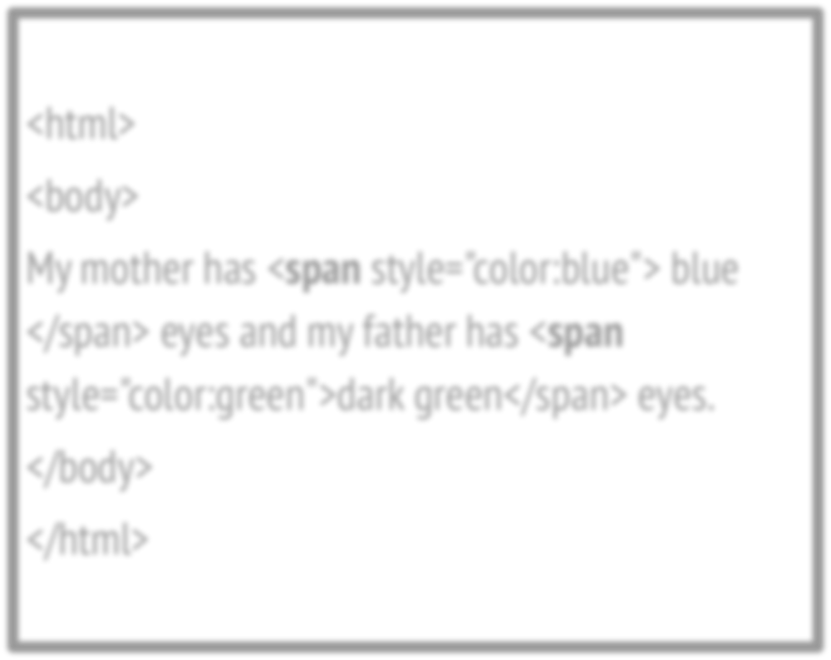
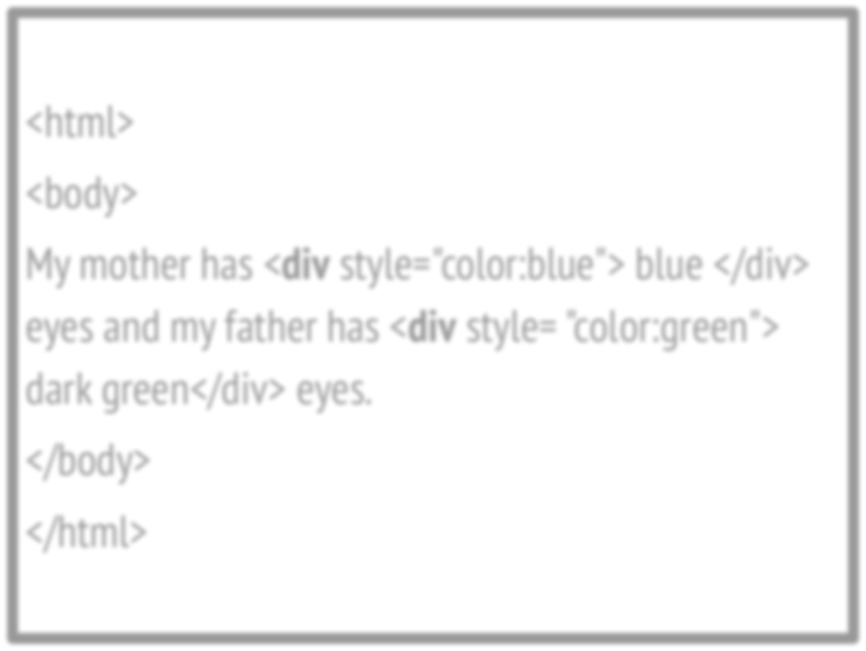
Span and Div tag- Value Addition
<html>
<body>
My mother has <span style="color:blue"> blue
</span> eyes and my father has <span style="color:green">dark green</span> eyes.
</body>
</html>
<html>
<body>
My mother has <div style="color:blue"> blue </div> eyes and my father has <div style= "color:green"> dark green</div> eyes.
</body>
</html>

Slide 65

Web Technology
Topic:
HTML Frames

Slide 66

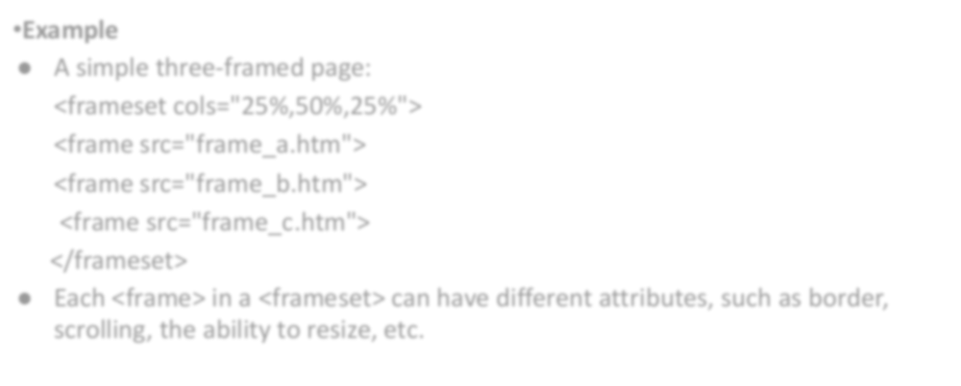
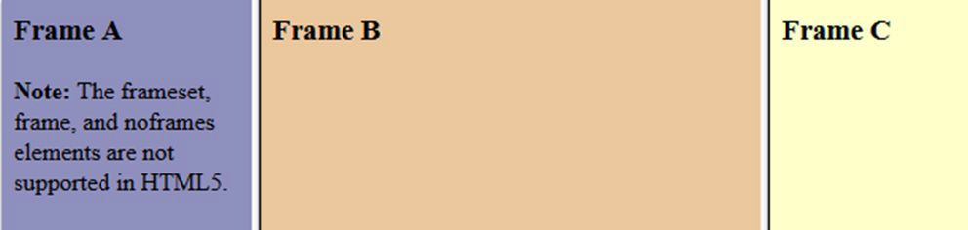
HTML Frames
Example
A simple three-framed page:
<frameset cols="25%,50%,25%">
<frame src="frame_a.htm">
<frame src="frame_b.htm">
<frame src="frame_c.htm">
</frameset>
Each <frame> in a <frameset> can have different attributes, such as border, scrolling, the ability to resize, etc.

Slide 67

Web Technology
Topic:
HTML Forms

Slide 68

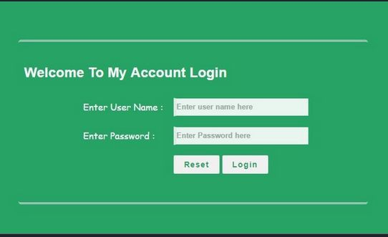
HTML Form Example-1- Login Page

Slide 69


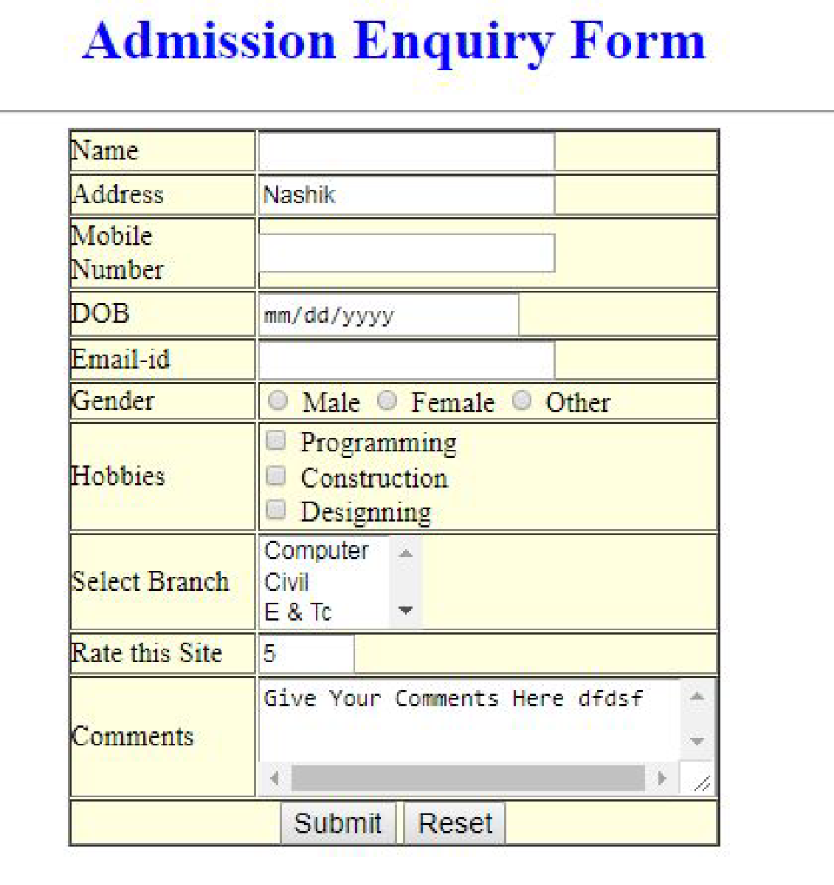
HTML Forms – Example 2 Registration Form

Slide 70
HTML Form Elements
Tag | Description
<form> | Deﬁnes an HTML form for user input
<input> | Deﬁnes an input control
<textarea> | Deﬁnes a multiline input control (text area)
<label> | Deﬁnes a label for an <input> element
<select> | Deﬁnes a drop-down list
<option> | Deﬁnes an option in a drop-down list
<button> | Deﬁnes a clickable button

Slide 71
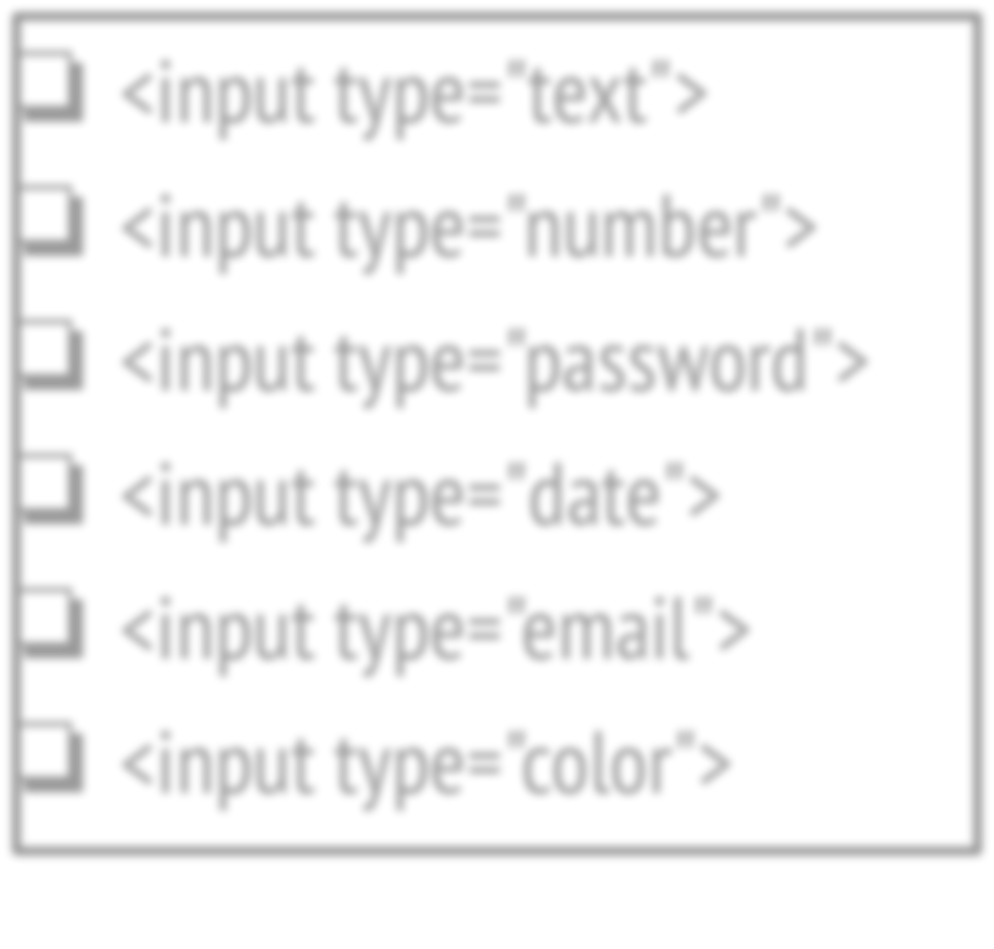
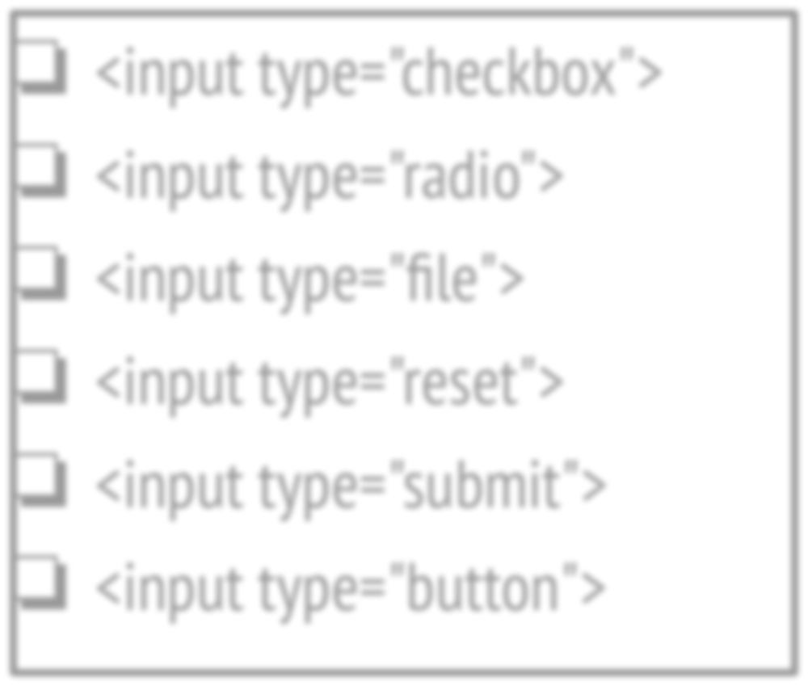
HTML Input Types
❏ <input type="text">
❏ <input type="number">
❏ <input type="password">
❏ <input type="date">
❏ <input type="email">
❏ <input type="color">
❏ <input type="checkbox">
❏ <input type="radio">
❏ <input type="ﬁle">
❏ <input type="reset">
❏ <input type="submit">
❏ <input type="button">

Slide 72
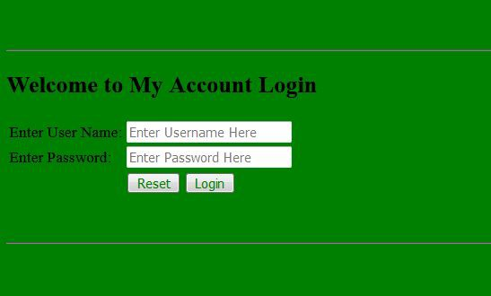
HTML Form Example-1- Login Page

Slide 73


<html>
<body bgcolor=green>
<br><br><hr>
<h2> Welcome to My Account Login </h2>
<table>
<tr>
<td>Enter User Name:</td>
<td>
<input type=text placeholder="Enter Username Here">
</td></tr>
<tr>
<td>Enter Password:</td>
<td>
<input type=password placeholder="Enter Password Here">
</td></tr>
<tr>
<td></td>
<td>
<input type=reset value=Reset style=color:green>
<input Type =submit value=Login style=color:green>
</td>
</tr>
</table>
<br><br><hr>
</body>
</html>

Slide 74

HTML Forms – Example 2 Registration Form

Slide 75


<html>
<body >
<h2 align=center> Registration Form </h2>
<table b>
<tr>
<td>My Photo</td>
<td><input type=ﬁle></td>
</tr>
<tr>
<td>Name</td>
<td><input type=text></td>
</tr>
<tr>
<td>Address</td>
<td><input type=text></td>
</tr>
<tr>
<td>Mobile </td>
<td><input type=text></td>
</tr>
<tr>
<td>DOB </td>
<td><input type=date></td>
</tr>
<tr> <td>color </td>
<td><input type=color></td> </tr>
<tr>
<td>Gender </td>
<td>
<input type=radio>Male
<input type=radio>FeMale
</td>
</tr>
<tr>
<td>Hobbies </td>
<td>
<input type=checkbox>Cricket
<input type=checkbox>Hockey
</td>
</tr>

Slide 76


<tr>
<td>Select Branch </td>
<td>
<select size=2>
<option> Computer</option>
<option> IT</option>
<option> Civil</option>
</select>
</td>
</tr>
<tr>
<td>Rate this site </td>
<td>
<input type=number min=1 max=5>
</td>
</tr>
<tr>
<td>Comment </td>
<td>
<textarea col=10 rows=3>
</textarea>
</td>
</tr>
<tr>
<td colspan=2 align=center>
<button >Click</button>
<button >Reset</button>
</td>
</tr>
</body>
</html>

Slide 77

Web Technology
Topic:
Difference Between HTML & HTML5

Slide 78
Html | Html5
DOCTYPE declaration in Html is too longer | DOCTYPE declaration in Html5 is very simple "<!DOCTYPE html>
character encoding in Html is also longer <!DOCTYPE HTML PUBLIC "-//W3C//DTD HTML 4.0 Transitional//EN"> | character encoding (charset) declaration is also very simple <meta charset="UTF-8">
Audio and Video are not part of HTML4 | Audio and Videos are integral part of HTML5 e.g. <audio> and <video> tags.
Vector Graphics is possible with the help of technologies such as VML, Silverlight, Flash etc | Vector graphics is integral part of HTML5 e.g. SVG and canvas
It is almost impossible to get true GeoLocation of user browsing any website especially if it comes to mobile devices. | JS GeoLocation API in HTML5 helps identify location of user browsing any website (provided user allows it)
.It provides local storage in place of cookies. | Html5 use cookies
Not possible to draw shapes like circle, rectangle, triangle. | Using Html5 you can draw shapes like circle, rectangle, triangle.
Does not allow JavaScript to run in browser. JS runs in same thread as browser interface. | Allows JavaScript to run in background. This is possible due to JS Web worker API in HTML5
Works with all old browsers | Supported by all new browser.

Slide 79

Web Technology
Topic:
CSS- Cascading Style sheet

Slide 80



CSS
CSS
Cascading
Style
Sheets

Slide 81



CSS-Syntax
SPV
Selector
Property
Value
Selector{ Property : Value;}
P { color : red ;}

Slide 82
CSS-Syntax
Selector
HTML tag
Id
Class
p { color : red ;}
#a { color : red ;}
.a { color : red ;}
<p> Hello </p>
<p id=a> Hello</p>
<p class=a> Hello</p>

Slide 83

Types of CSS
Types of CSS
Inline
Internal
External

Slide 84



Types of CSS
Write CSS code inside HTML Tag
CSS code as attribute of HTML tag
Code starts with Style
Example: <p style= “color:red” >
Inline CSS

Slide 85



Types of CSS
Write CSS code inside HTML
Head Tag
Use <style> tag inside Head tag
Internal CSS
Example:
<head>
<style>
p { color: red;}
</style>
</head>

Slide 86


Types of CSS
2 Files
1> .html 2> .css
write css code in .css file
External CSS
Give link of .css file inside .html file, under head tag, in <link> tag

Slide 87

External CSS Example
a1.html
a2.css
<html>
<head>
<link rel="stylesheet" type="text/css" href="a2.css">
</head>
<body>
<p> Hello Good Morning </p>
</body> </html>
p { color: red;}

Slide 88

When to use which Types of CSS
Types of CSS
Inline
Internal
External
When your website is having multiple html files and you want same style to be applied for every html page
When you want to use css property for only one tag in html
When you want to use css property for more than one tag and you have only one html file.

Slide 89


CSS Properties
❏ CSS Color
❏ CSS background
❏ CSS Border
❏ CSS Text
❏ CSS Font
❏ CSS Margin
❏ CSS Padding
❏ CSS Table

Slide 90


CSS Properties- Color
❏ color: value
❏ Example:
❏ color : blue;

Slide 91


CSS Properties-background
background-color
Example:
h1 { background-color: green; }
background-image
Example:
body { background-image: url("paper.gif");}

Slide 92


CSS Properties- border
border-style (dotted,dashed,solid,double etc)
Example: P {border-style: dotted;}
border-width (value in px)
Example: P {border-width: 5px;}
border-color (red, blue, green etc)
Example: P {border-color: red;}
border-radius (value in px)
Example: P{border-radius: 12px;}

Slide 93


CSS Properties -Text
❏ color
❏ background-color
❏ text-alignment (left, right, center, justify)
❏ text-decoration (overline, underline, linethrough)
❏ text-transform (uppercase, lowercase, capitalize)

Slide 94


CSS Properties- Font
❏ Font-family
❏ Font-Style( normal, italic)
❏ font-size( in px)
❏ font-weight(normal,bold)

Slide 95


CSS Properties- Margin
❏ margin-top
❏ margin-right
❏ margin-bottom
❏ margin-left

Slide 96


CSS Properties- Padding
❏ padding-top
❏ padding-right
❏ padding-bottom
❏ padding-left

Slide 97


CSS Box Model

Slide 98


CSS Properties- Table
❏ tr:hover {background-color: grey;}
❏ tr:nth-child(even) {background-color: green;}
❏ Size
❏ Border

Slide 99

Web Technology
Topic: Bootstrap

Slide 100



Bootstrap
Bootstrap is the most popular HTML, CSS, and JavaScript framework
for developing responsive, mobile-ﬁrst websites.
Bootstrap History
Bootstrap was developed by Mark Otto and Jacob Thornton at Twitter, and released as an open source product in August 2011 on GitHub.
In June 2014 Bootstrap was the No.1 project on GitHub!

Slide 101





Bootstrap- Advantages
Easy to use: Anybody with just basic knowledge of HTML and CSS can start using Bootstrap
Responsive features: Bootstrap's responsive CSS adjusts to phones, tablets, and desktops
Mobile-ﬁrst approach: In Bootstrap 3, mobile-ﬁrst styles are part of the core framework
Browser compatibility: Bootstrap is compatible with all modern browsers (Chrome, Firefox, Internet Explorer, Safari, and Opera)

Slide 102


Bootstrap Grid

Slide 103

Bootstrap Grid
Bootstrap's grid system allows up to 12 columns across the page.
If you do not want to use all 12 columns individually, you can group the columns together to create wider columns
Bootstrap's grid system is responsive, and the columns will re-arrange automatically depending on the screen size.

Slide 104
Bootstrap Grid
xs
(for phones - screens less than 768px wide)
sm
(for tablets - screens equal to or greater than 768px wide)
md
(for small laptops - screens equal to or greater than 992px wide)
lg
(for laptops and desktops - screens equal to or greater than 1200px wide)

Slide 105
Bootstrap Grid
<div class="row">
<div class="col-*-*"></div>
<div class="col-*-*"></div>
</div>
<div class="row">
<div class="col-sm-4"></div>
<div class="col-sm-4"></div>
<div class="col-sm-4"></div>
</div>
.col-sm-4 | .col-sm-4 | .col-sm-4

Slide 106

Bootstrap- Where to get?
Where to get Bootstrap?
Two Options
Download Bootstrap from getbootstrap.com
Include Bootstrap from a CDN

Slide 107

<html>
<head>
CDN- Mandatory Lines for Bootstrap in every code
<link rel="stylesheet" href="https://maxcdn.bootstrapcdn.com/bootstrap/3.4.1/css/bootstrap.min.css">
<script src="https://ajax.googleapis.com/ajax/libs/jquery/3.5.1/jquery.min.js"></script>
<script src="https://maxcdn.bootstrapcdn.com/bootstrap/3.4.1/js/bootstrap.min.js"></script>
</head>
<body>
<div class="row">
<div class="col-sm-4" style="background-color : pink"> Col1 Data </div>
<div class="col-sm-4" style="background-color : yellow"> Col2 Data </div>
<div class="col-sm-4" style="background-color : lavender"> Col3 Data </div>
</div>
Change value of Col-*-*
</body>
</html>
according to your need
Example-

Slide 108


References
Websites:
❏ https://www.w3schools.com/html/
❏ https://www.w3schools.com/css/
❏ https://www.w3schools.com/bootstrap/

